Slide 1
Additional Topics – Part 1

Slide 2
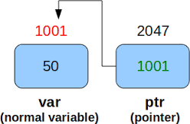
Topics
Namespaces
Pointers
Dynamic memory
Object persistence
Conditional compilation

Slide 3
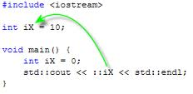
Scope Resolution Operator
The scope operator :: also allows access to global variables even though there are local variable of the same name
It is not a good idea to use global variables, but one should understand this construct to understand someone else’s code
Note: local variables take precedence over global variables

Slide 4
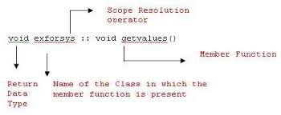
Scope Resolution Operator
The scope operator :: is also used with namespaces and C++ classes
See example: namespace1.cpp

Slide 5
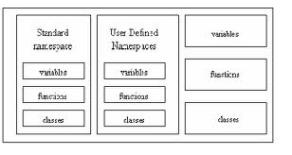
Namespaces
When a header file, such as iostream, is included in a program, the global identifiers in the header file also become the global identifiers in the program
If a global identifier in a program has the same name as one of the global identifiers in the header file, the compiler will generate syntax error (such as identifier redefined)

Slide 6
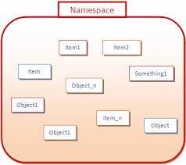
Namespaces
The same problem can occur if a program uses third party libraries
ANSI/ISO standard C++ attempts to solve this problem of overlapping global identifier names with the namespace mechanism

Slide 7
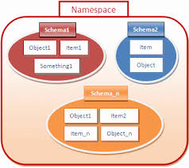
More on Namespaces
A namespace is a space (that is a section of code) which is enclosed by braces
Includes only definitions or other namespaces
Scoping mechanism that is used to identify variables clearly within different blocks of code
The general idea of namespaces is to declare identifiers with namespace scope
The header files (such as <iostream>) declare all their identifiers to be in a namespace called std

Slide 8
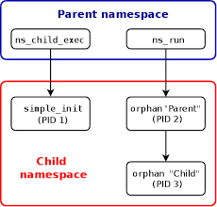
Syntax of a Namespace
namespace nameSpaceName
{
[declarations of members]
}
where a member is usually a variable declaration, a named constant, a function, or another namespace

Slide 9

Creating a Namespace
namespace globalType
{
const int n = 10;
const double rate = 7.50;
int count = 0;
void printResult();
}
defines globalType to be a namespace with four members

Slide 10
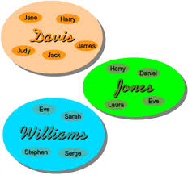
Scope of a Namespace Member
The scope of a namespace member is local to the namespace
There are two ways a namespace member can be accessed outside the namespace

Slide 11
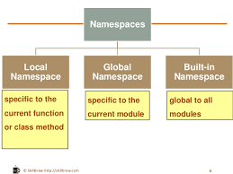
First Way to Access Namespace Identifiers
Use a qualified name consisting of the namespace, the scope resolution operator :: and the desired the identifier
Syntax: Accessing a namespace Member
namespace_name::identifier
To access the member rate of the namespace globalType, the following statement is required:
globalType::rate
To access the member printResult (which is a function), the following statement is required:
globalType::printResult( );
See example namespace2.cpp

Slide 12
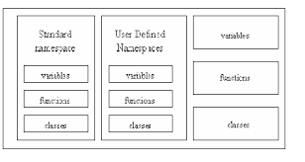
First Way to Access Namespace Identifiers
To access members within iostream
std::cout << std :: endl ;
ios::scientific
See example namespace3.cpp

Slide 13
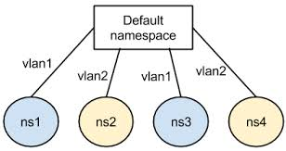
Utilizing Two Namespaces
namespace firstNameSpace
{
int nameSpaceVariable=5;
}
namespace secondNameSpace
{
int nameSpaceVariable=10;
}
// utilizing namespace variables
firstNameSpace::nameSpaceVariable secondNameSpace::nameSpaceVariable
See example namespace4.cpp

Slide 14

Second Way to Access Namespace Identifiers
Using a declaration
Syntax:
(a) using namespace namespaceMember;
or
(b) To simplify the accessing of a specific namespace member:
using namespaceName:: namespaceMember;

Slide 15

Second Way to Access Namespace Identifiers
For globalType namespace:
using namespace globalType;
or
using globalType::rate;
After the using statement
To access a namespace member it is not necessary to precede the namespace_name and the scope resolution operator before the namespace member

Slide 16

“using” Example
namespace globalType
{
const int n = 10;
const double rate = 7.50;
int count = 0;
void printResult();
}
using namespace globalType;
See examples namespace5.cpp and namespace6.cpp

Slide 17

“using” Examples for iostream
For iostream
#include <iostream>
using std::cout ;
using std::endl ;
using namespace std;
A function can refer to the global identifiers of the header file iostream without using the prefix std:: before the identifier name
If a namespace member and a global identifier in a program have the same name
To access this namespace member in the program, the namespace_name and the scope resolution operator must precede the namespace member
See examples namespace7.cpp through namespace10.cpp

Slide 18
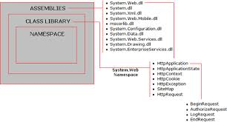
Another namespace Example
#include <iostream>
using namespace std;
int myVariable=7;
namespace myNameSpace
{
char myVariable='t';
}
using namespace myNameSpace;
int main()
{
double myVariable=12.0;
cout << "myVariable defined in main " << myVariable << endl;
cout << "global myVariable " << ::myVariable << endl;
cout << "myVariable defined in myNameSpace " << myNameSpace::myVariable
See example namespace11.cpp

Slide 19
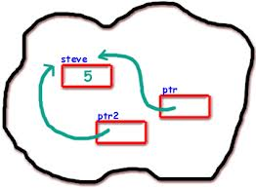
What is a Pointer Variable?
A pointer variable is a variable whose value is the address of a location in memory
To declare a pointer variable, one must specify the type of value that the pointer will “point to”
For example:
int * intPointer // intPointer can hold the address of an int
char * charPointer; // charPointer can hold the address of a char
See example: pointer1.cpp

Slide 20
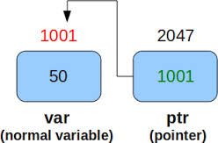
Dereferencing a Pointer Variable
The unary indirection (dereference) operator * is used to determine the value of the variable pointed to by a pointer variable
The value can be accessed or changed by using the dereferencing operator
value address
myInt 7 1000
myIntPtr 1000 4000
One can access the memory location using myInt or *myIntPtr
See example: pointer2.cpp

Slide 21
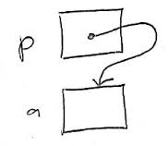
Classes, Structs, and Pointer Variables
One can declare pointers to other data types, such as classes and structs
struct studentType
{
char name[26];
double gpa;
int ssn;
char grade;
};
studentType student;
studentType* studentPtr;
studentPtr = &student;

Slide 22

Accessing Members
Three different ways to store 3.9 in the component gpa of the object student
student.gpa = 3.9;
(*studentPtr).gpa = 3.9;
studentPtr->gpa = 3.9;
Since dot has a higher precedence than the dereferencing operator, parentheses are important
C++ provides an operator, called the member access operator arrow, ->
The syntax for accessing a class (struct) member using the operator -> is
pointerVariableName->classMemberName

Slide 23
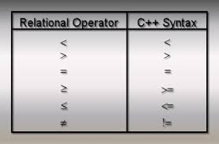
Operations using Pointer Variables
Assignment
Value of one pointer variable can be assigned to another pointer variable of the same type
Relational operations
Two pointer variables of the same type can be compared for equality, etc.
Some limited arithmetic operations
Integer values can be added and subtracted from a pointer variable
Value of one pointer variable can be subtracted from another pointer variable

Slide 24
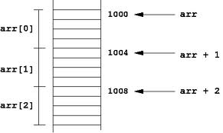
Pointer Arithmetic
Why is there a different pointer type for each type?
C++ does pointer arithmetic
To point to the variable, C++ must add a value the equal to the sizeof the type of the variable
charPtr + 1 is +1 (sizeof of char)
if charPtr contains the address 2400 then charPtr+1 contains 2401
intPtr +1 is +4 (sizeof of int)
if intPtr contains the address 2400 then intPtr+1 contains 2404
floatPtr+1 is +4 (sizeof of float)
if floatPtr contains the address 2400 then floatPtr+1 contains 2404
See examples: pointer3.cpp through pointer7.cpp

Slide 25
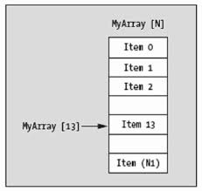
Differences between Arrays and Pointers
The name of an array evaluates to the address in memory of the first element in the array
It cannot be changed
It is called a pointer constant (Arrays are fixed in memory)
It cannot be used on the left-hand side of an assignment and intArray++ is illegal
Pointer variables can be changed
They can appear on either side on either side of an assignment statement
Assignments are allowed between array address and pointers

Slide 26
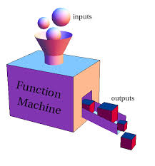
Arrays as Parameters to Functions
It is not possible to pass a copy of the array
The address of the array name serves as the parameter and the function can access the array elements through the address
Prototypes and function definitions
One can use pointer or array notation (In reality, array notation is same as dereferencing a variable)
Inside the function, the function can access the elements using array or pointer notation regarding of the type used on the function definition or prototype
Functions have no knowledge of the number of elements (just the type)
See examples: pointer8.cpp and pointer9.cpp

Slide 27
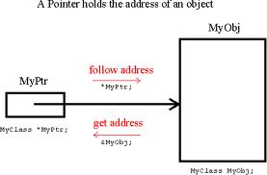
Differences Between Reference and Pointer Variables
* (dereference) and & (address of) operators are not used with reference variables
The compiler automatically dereferences reference variables
Reference variables must be initialized while pointer variables may or may not
The compiler treats a reference variable as if it is a constant pointer
cannot be reassigned after being initialized
See examples: pointer10.cpp and pointer11.cpp

Slide 28
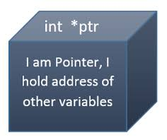
Pointers within Classes
See example: pointer12.cpp

Slide 29
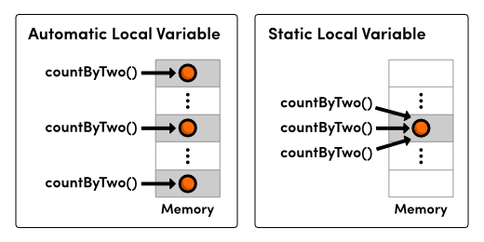
Types of C++ Variables
Static variables
Once defined, memory allocation exists throughout execution of program (initialized to zero upon creation)
static int myInt;
Automatic variables
Automatically created at function entry and is destroyed when returned from function
int myInt; or auto int myInt;
Static and automatic memory space allocation is done compile time
Dynamic variables
Explicitly allocated and deallocated during program execution
Efficient use of memory

Slide 30

Allocation of Memory
STATIC
ALLOCATION
Static allocation is the allocation of memory space at compile time
DYNAMIC
ALLOCATION
Dynamic allocation is the allocation of memory space at run time by using operator new

Slide 31
Operator new Syntax
Syntax:
new DataType
or
new DataType [IntExpression]
If memory is available in an area called the heap (or free store) the new operator allocates the requested object or array, and returns a pointer to (address of ) the memory allocated
Program terminates with error message if space in not available
The allocated memory is uninitialized
The dynamically allocated object exists until the delete operator destroys it
See example: dynamic1.cpp
31

Slide 32
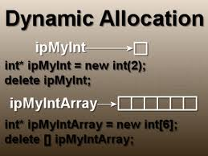
Using Operator delete
The “delete” operator returns to the free store (heap) memory which was previously allocated at run-time by “new” operator
The object or array currently pointed to by the pointer is deallocated
Pointer is considered unassigned
32

Slide 33
Operator delete Syntax
Syntax:
delete Pointer
or
delete [ ] Pointer
The object or array currently pointed to by Pointer is deallocated
Value of the Pointer is undefined
The memory is returned to the free store (heap)
Square brackets are used with delete to deallocate a dynamically allocated array
See example: dynamic2.cpp
33

Slide 34

Inaccessible Object
An inaccessible object is an unnamed object that was created by operator new and which a programmer has left without a pointer to it
A memory leak is the loss of available memory space that occurs when dynamic data is allocated but never de-allocated

Slide 35
Making an Object Inaccessible
ptr
ptr2
int* ptr = new int;
*ptr = 8;
int* ptr2 = new int;
*ptr2 = -5;
ptr = ptr2;
// here the 8 becomes inaccessible
see example: dynamic3.cpp
8
-5
ptr
ptr2
8
-5

Slide 36
A Dangling Pointer
Is a pointer that points to dynamic memory that has been deallocated
int* ptr = new int;
*ptr = 8;
int* ptr2 = new int;
*ptr2 = -5;
ptr = ptr2;
delete ptr2;
// ptr is left dangling
ptr
ptr2
8
-5

Slide 37

Object Persistence
All objects have a life cycle
Object are created
Object exist and are accessible
Objects are terminated (destroyed)
Object persistence characterizes the different object creation and termination mechanisms

Slide 38
Types of Persistence
Automatic
Objects are created at an arbitrary point (usually in a block) and are automatically terminated at the end of scope
Static
Once objects are created they are in memory until the final explicit instruction of the program
Dynamic
Objects are created at an arbitrary point and are terminated under programmer control
Type of persistence should be chosen for a particular object depending on context

Slide 39

Automatic Persistence
Usually declared in a block
Default mechanism in C++
Usually exists for a short lifetime
Exists on the run time stack (stack grows and shrinks as objects come and go)
See example: dynamic4.cpp

Slide 40

Static Persistence
Once defined, objects exist throughout the program
Global implies static
See example: dynamic5.cpp

Slide 41

Dynamic Persistence
Objects put on the heap using the “new” operator
Objects removed from the stack using “delete” operator
See examples: dynamic6.cpp and dynamic7.cpp

Slide 42
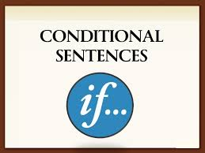
Conditional Compilation (Pre-processor Directives)
#define - defines symbols to the compiler
#ifdef - test whether a symbol is defined to the compiler
#else - provides an alternative to the #ifdef
#elif - used to build a compound conditional directive
#endif - signals the end of the body of an if directive
#ifndef - tests whether a symbol is not defined
#if - tests values of a constant expression
See examples: cc1.cpp through cc4.cpp

